Slide 1
StudiBuddi
Sprint 0
Piratez

Slide 2
User Need
College students need the ability to
receive help in their courses
develop quality studying habits
expand their network amongst students
To obtain this
In a comforting manner
With support and motivation
Safely

Slide 3
Solution
A web application platform that enables students to:
Freely share what they need to study for or receive help on
Connect with other students to study for material they both struggle with
Schedule study meetings between two students to allow them to both receive help and expand their network
Notes:
Add value proposition? (from quickpik)

Slide 4
Technology We’re Using
Web Application
HTML, CSS, and JavaScript
PHP
Database
MySQL
Notes:
DON’T KNOW WHERE THIS SLIDE SHOULD GO

Slide 5
Technology Innovation
Utilize Machine Learning to:
Automatically suggest a study meetup time between two students
Help students discover other students who study similarly to them
Suggest a recommended hot spot on campus to study at
Based on students current location
Notes:
Possible: review system

Slide 6
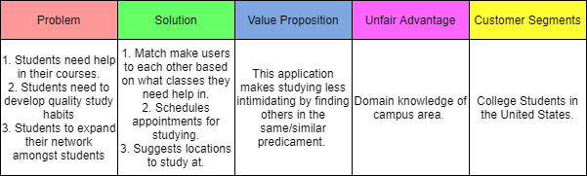
Strategy
Notes:
Domain knowledge of the campus; first to

Slide 7
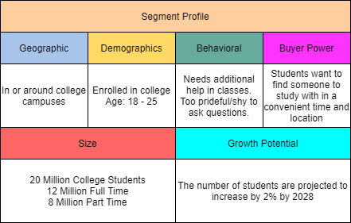
Market Segment
Notes:
Behavioral: Those having trouble in class,
Buyer Power: Students wants to find someone to study with in a convenient time and location

Slide 8
Strengths
Allows students that are too shy to ask their instructor for help
More accessible than the tutoring center because it allows people to match up if they struggle with the same subject
Encourages students to meet together and socially interact in a comfortable location of their choosing
This team is experienced in using databases
This team is a part of our target demographic and we know what this demographic struggles with

Slide 9
Weaknesses
The team is not experienced in PHP, or Javascript
This will be the first time the team will make a web application that requires interaction between multiple users
Our team has does not have experience with machine learning

Slide 10
Opportunities
This application could be expanded to other departments, we are using the CECS department as our small sample size
After integrating to other departments, we can expand this to other universities
The use of machine learning when suggesting locations for students to study together
This application works the best with a narrow demographic with many users

Slide 11
Threats
Quizlet is an app that many college students use to study and the amount of time and it easy for students to know what they do and do not understand about a topic in their class
Shy students may not find the app approachable if they need help but are not able to reach out and ask for help

Slide 12

Justina Pickle, The Shy Student
Personal Background
20 Years old
Full time student
Part time job
Lifestyle
Has class every morning Monday - Friday
Can only study in the afternoon
Challenges
Doesn’t have friends to study with
Scared to approach new people
Too shy to go to professor’s office hours

Slide 13

Sean Curly, The New Student
Personal Background
18 Years old
Full time Student
Transferred from a community college
Lifestyle
Has class Monday - Thursday
Bad time management skills
Challenges
Can’t set a time to study
Doesn’t know where to study at
Doesn’t know many other students in his classes
Notes:
Rofl Sean Curly

Slide 14
Primary Market Research
Surveys posted to Reddit and given to my tutoring students (mostly 1st and 2nd year engineering majors)
10 Questions + 2 Demographic & 2 Free response sections
Demographic Questions: Asked age and whether they have been or are currently in college
Other questions all pertaining to user needs and application specifics
Notes:
We will need a new survey

Slide 15
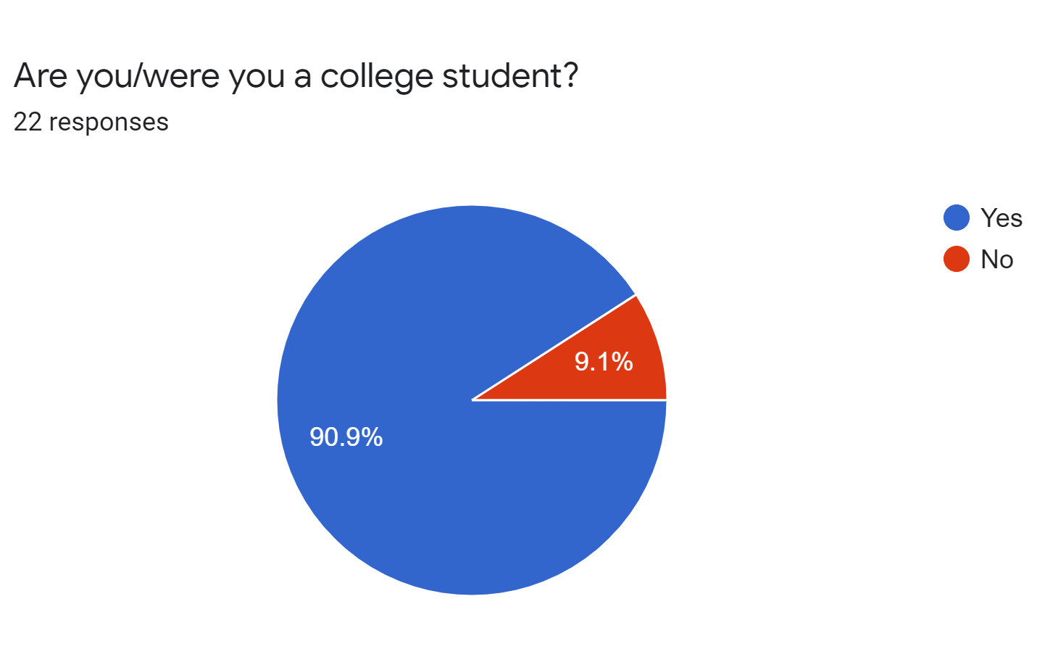
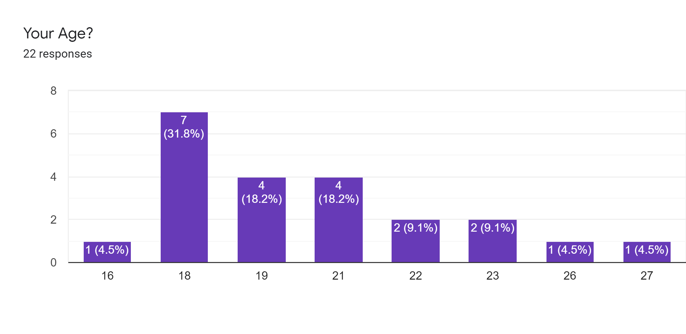
Primary Market Research Results - Demographics
Average age: 20, Median: 19

Slide 16
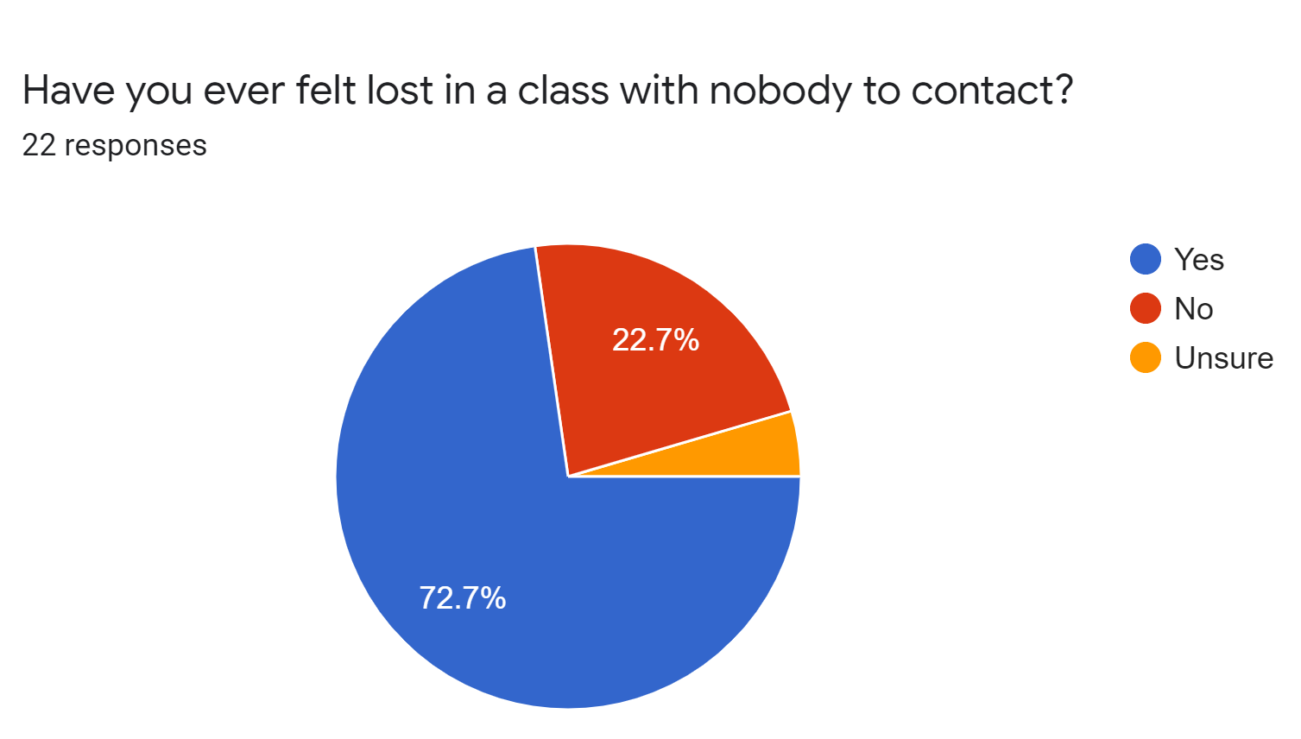
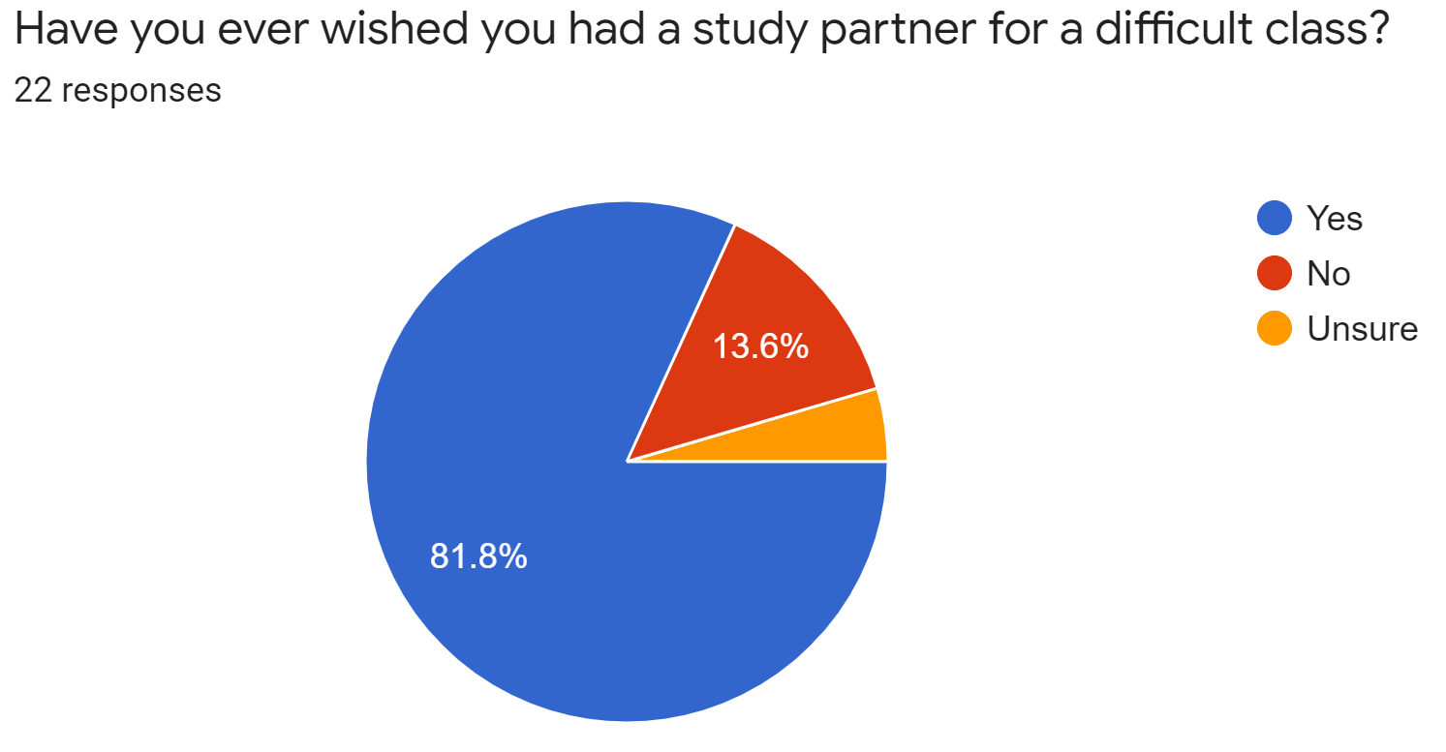

Slide 17
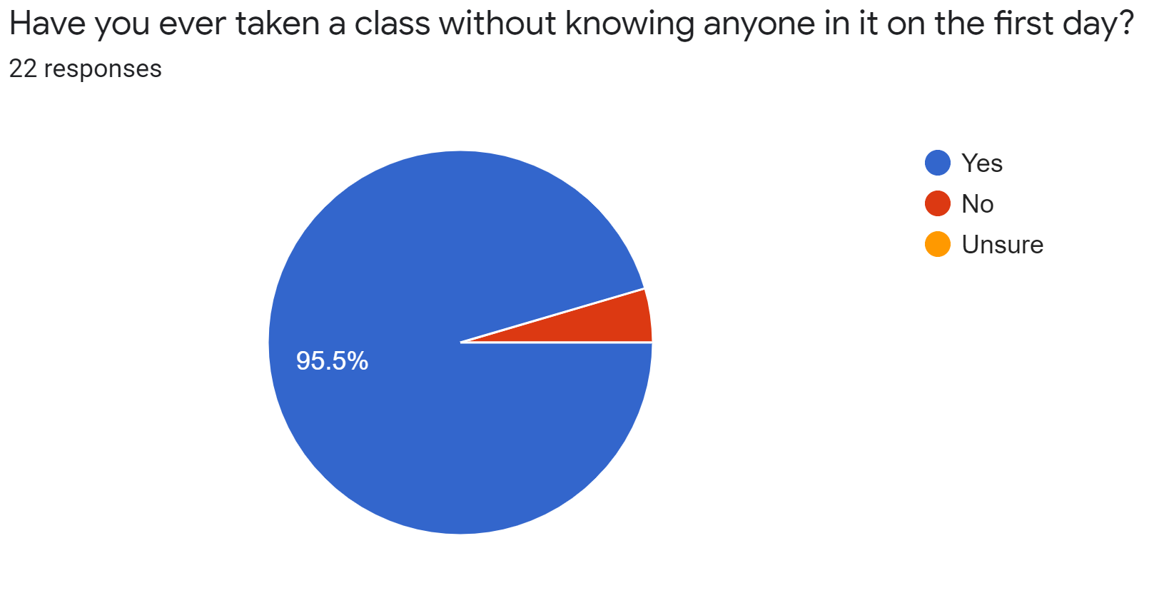
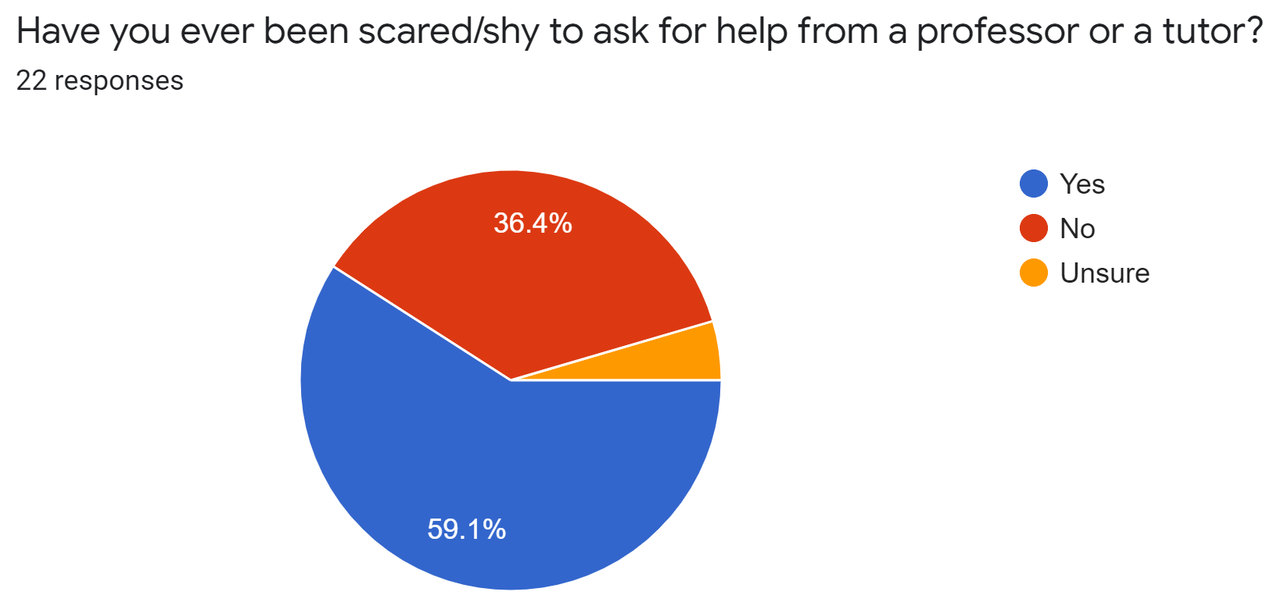
Primary Market Research Results - 3

Slide 18
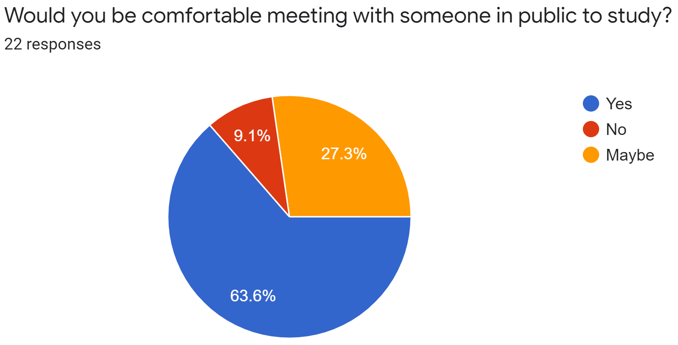
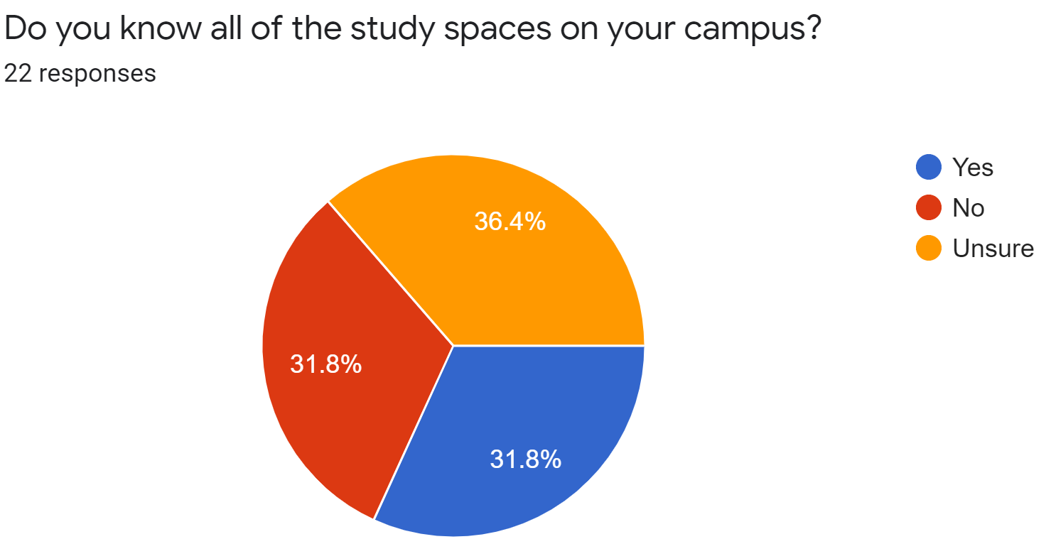
Primary Market Research Results - 3

Slide 19
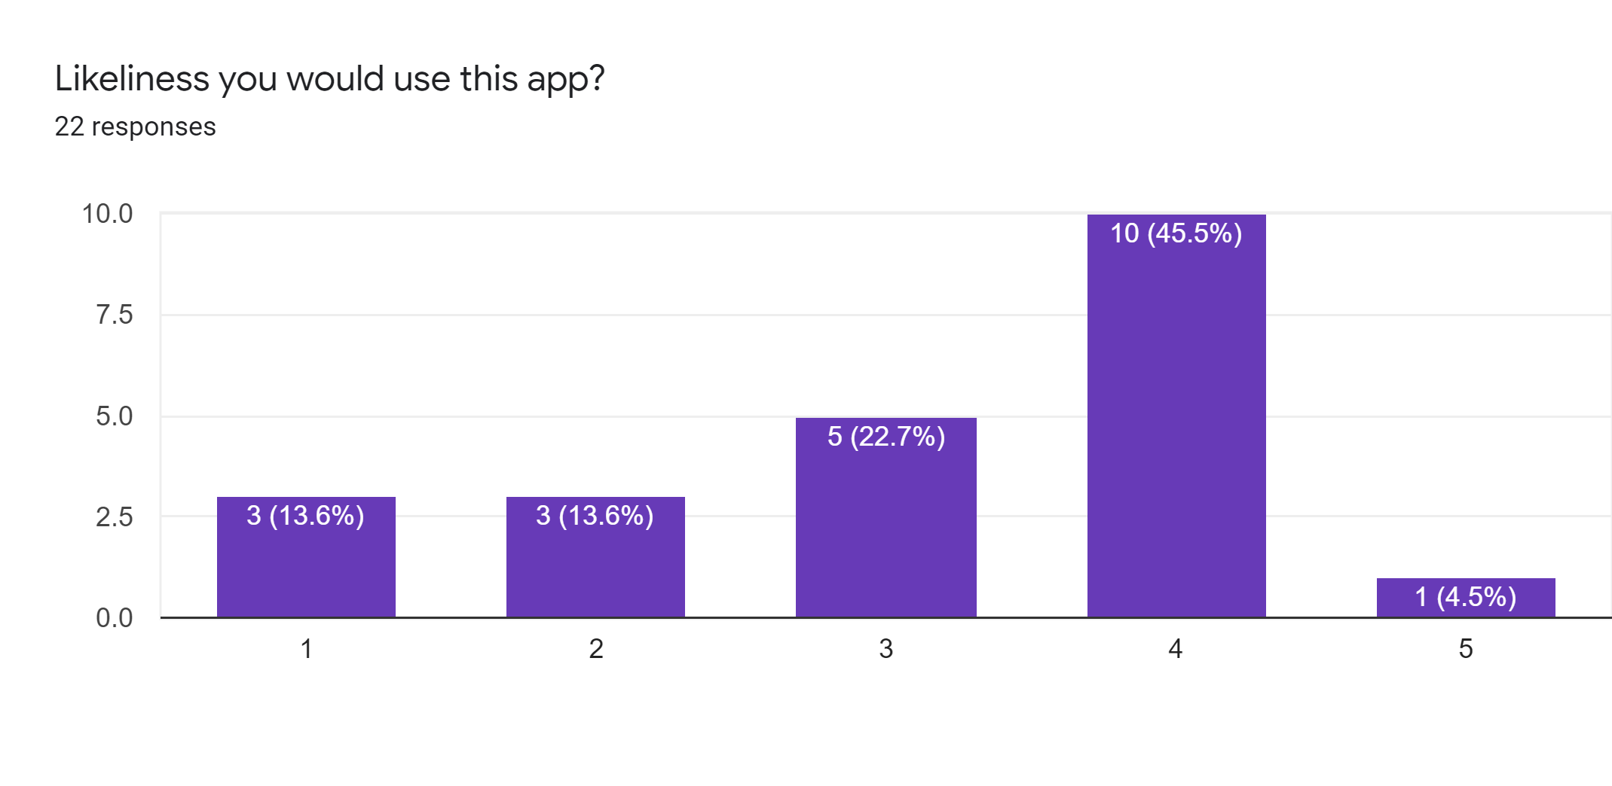

Slide 20
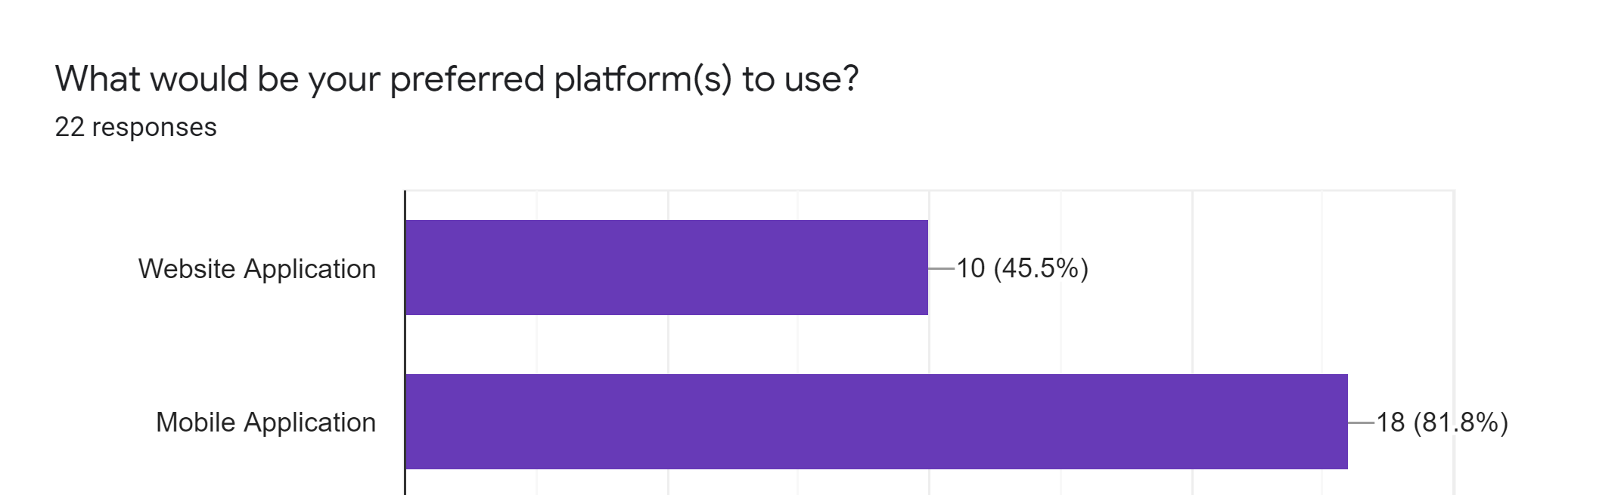
Primary Market Research Results - Preferred Platform
Large market segment for those who would prefer a mobile app or mobile-friendly website

Slide 21
Primary Market Research - Additional Features Requested
Calendar-type features (i.e. blocking out times when in class, meeting scheduling)
Notifications from the app/webapp
Timer features to track your studying
Some aspect of social features (profile with your preferred/current subjects)
Cross-platform support

Slide 22
Secondary Market Research
The global Application Platform market is valued at USD 3.23 billion by the end of 2024, growing at a CAGR of 4.83% during 2020-2024.
The rapid application development market size is expected to grow from USD 7.8 billion in 2018 to USD 46.2 billion by 2023, at a Compound Annual Growth Rate (CAGR) of 42.9% during the forecast period.
Two main study help web Chegg.com has reported 2.23 million subscribers at 2019 and Coursehero.com says you can study 30 million course-specific resources in their website

Slide 23
Most Significant Competitor: GoConqr
Strengths
Offers many features that allow students to receive instant help on a wide range of topics
Mind Maps
Study Planner
Library
“Learning Groups” enable people to connect over the same topic
Weaknesses
Don’t go the extra mile to allow people to meet and study in real life
Lots of manual work required by the user

Slide 24
Other Competitors
“Ask Around” App
Strengths
Allow user ask question at specific location
Can limit the range of who can see the question
Weakness
Lack of subject and classification
Not for specific group of people

Slide 25
Other Competitors
BuddyUp (web)
Used to be Social studying app that enables users to private message and create study groups
Now they are focused on group people for event
HoopMaps
Matchmaking app for basketball
Schedule and productivity apps
Google Calendar
ZenDay
Any.do

Slide 26
Other Competitors
Quizlet:Users can create “sets” in any subject under the sun, and based on the set the website will generate flashcards, quizzes, practice tests, matching games, and even auditory tools.
StudyBlue: Collaboration is the name of the game for this website. StudyBlue connects students through similar learning goals and subjects, allowing them to share and access flashcards, study guides, and more.
Course Hero: Course Hero is an education technology website company, which operates an online learning platform for students to access course-specific study resources contributed by a community of students and educators.
Chegg: Chegg provides digital and physical textbook rentals, online tutoring, and other student services

Slide 27
Secondary Market Links
By. “Application Platform Market Size, Share 2020 Global Industry Trends, Demand, Growth Opportunities, Industry Revenue, Future and Business Analysis by Forecast – 2024.” MarketWatch, 2 Jan. 2020, www.marketwatch.com/press-release/application-platform-market-size-share-2020-global-industry-trends-demand-growth-opportunities-industry-revenue-future-and-business-analysis-by-forecast-2024-2020-01-02.
Carter, Joanna, and Gavin Llewellyn. “Global Social Media Research Summary 2019.” Smart Insights, 25 Oct. 2019, www.smartinsights.com/social-media-marketing/social-media-strategy/new-global-social-media-research/.
“Application Platform Market.” Market Research Firm, www.marketsandmarkets.com/Market-Reports/application-platform-market-28942023.html.
“Chegg Reports Q2 2019 Financial Results and Raises Full Year 2019 Guidance.” Yahoo! Finance, Yahoo!, 29 July 2019, finance.yahoo.com/news/chegg-reports-q2-2019-financial-200500912.html.
Siegler, MG. “An Unlikely Entrant In The Location App Race At SXSW: Ask.com.” TechCrunch, TechCrunch, 3 Mar. 2011, techcrunch.com/2011/03/03/ask-around-app/.
Admin. “How Big Is Mobile App Industry?” BizzSmartz, 18 Mar. 2019, www.bizzsmartz.com/how-big-is-mobile-app-industry/.

Slide 28
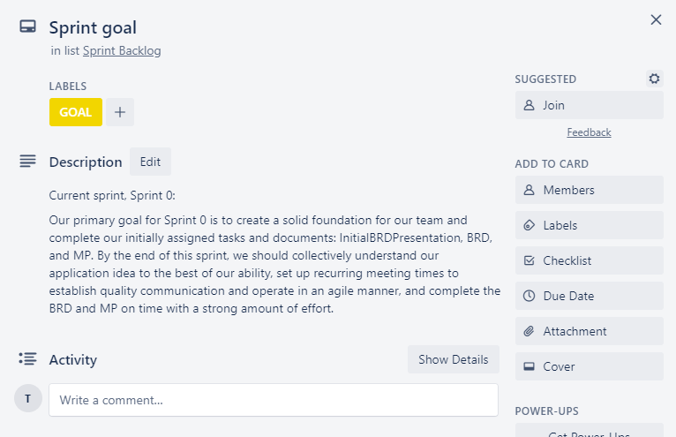
Sprint Goal

Slide 29
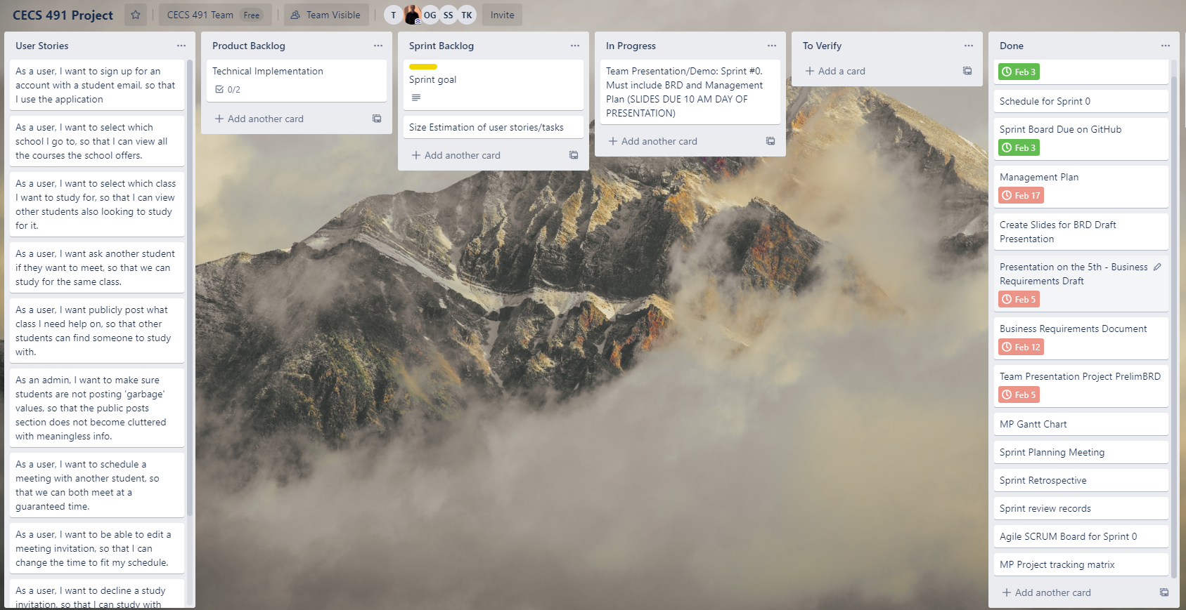
Sprint Board
Notes:
ALL USER STORIES FALL INTO “MUST HAVE” CATEGORY, BC WE HAVEN’T THOUGHT OF ANY “EXCITERS”

Slide 30
Sprint 0 Retrospective
Most significant conclusion
Our previous idea lacked direction and clarity, causing negativities throughout our team
Other key takeaways
General lack of structure
Team morale was low
Determined more time and effort needed to be put into our work
Poor communication

Slide 31
Sprint Review
Completed on time
Sprint planning meeting
Initial BRD presentation
Management Plan
Business Requirements Document
Needs review
Business Requirements Document
Needs to be refactored for new app
We want to put in more effort

Slide 32
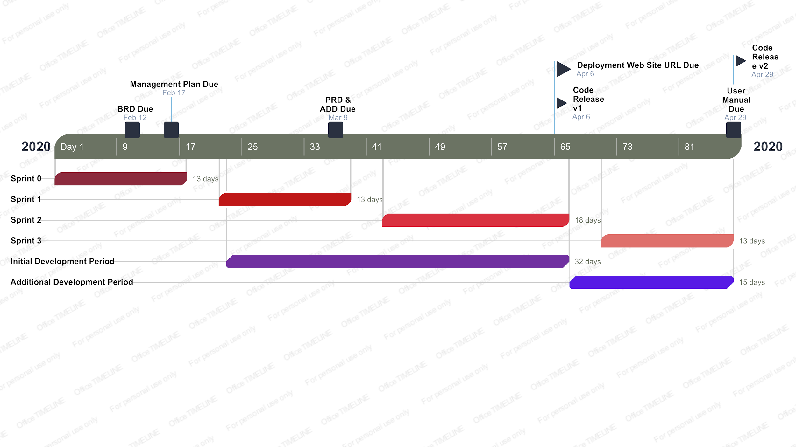
Gantt Chart

Slide 33
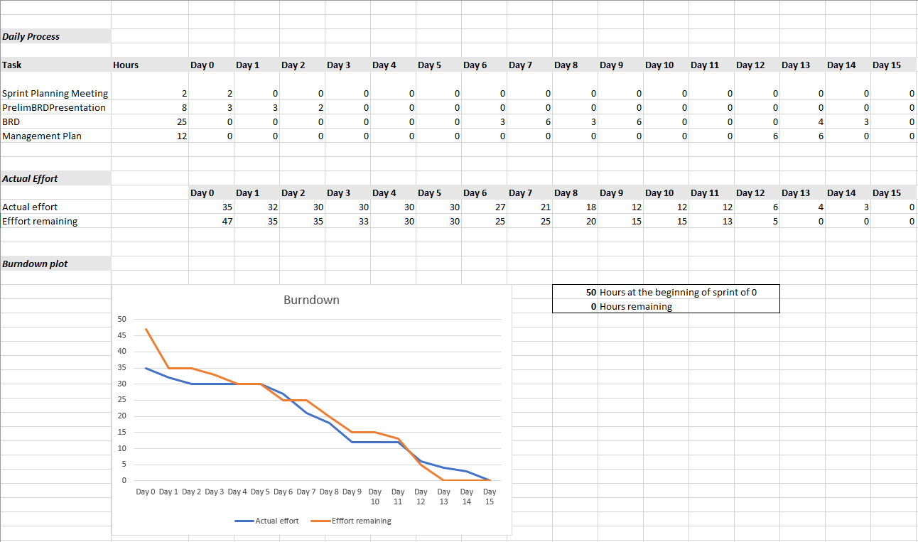
Burndown Chart
Notes:
60 STORY POINTS COMPLETED

Slide 34
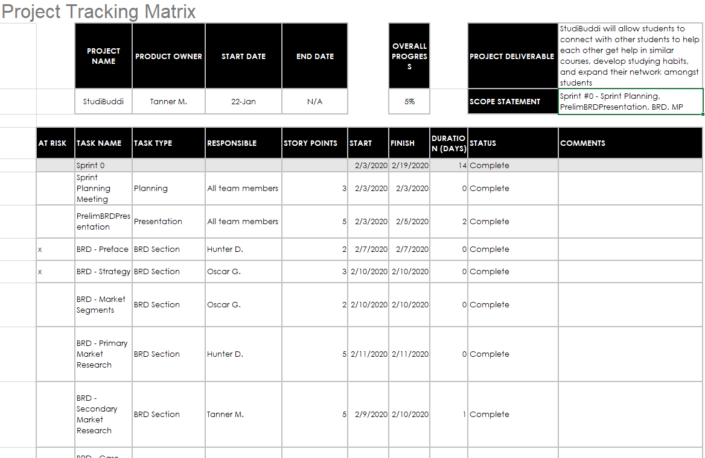
Project Tracking Matrix

Slide 35
Plans for Sprint 1
High priority
Refactor the Business Requirements Document
Complete the Product Requirements Document
Complete the Architecture and Design Document
Medium-High priority
Set up a database
If possible
Start web programming

Slide 36
Velocity
60 hours or “story points”
20 - Product requirements document
20 - Architecture and Design Document
10 - Refactor the Business Requirements Document
10 - Set up a database

